Slide 1
IBM University Engagement Project Submission
“Exploring the Power of Agentic AI with IBM Granite and LangFlow”

Slide 2

Project Tile – The Manufacturing Process Quality Control
Agent
Domain of Project – Manufacturing
Student Name | Recent Passport Photo | Email ID | Mobile number [WhatsApp]
DHIRENKUMAR HARESHBHAI JOSHI |  | dhirenjoshi7@gmail.com | 9033822624

Slide 3
Problem Statement - The Manufacturing Process Quality Control Agent
Problem Statement : Quality Control Agent
The Challenge
In modern manufacturing industries, maintaining consistent product quality is critical for customer satisfaction, safety, and regulatory compliance. However, manufacturing processes often involve multiple machines, materials, and environmental conditions that can affect product quality. Small variations in temperature, pressure, machine calibration, or material properties can lead to defects such as dimensional inaccuracies, surface imperfections, or structural weaknesses. Traditional quality control methods rely heavily on manual inspection or periodic sampling, which may fail to detect defects early in the production process. As production volumes increase, manual inspection becomes inefficient and prone to human error. Manufacturers require intelligent systems that can continuously monitor production parameters, detect anomalies, and predict quality issues beforedefective products are produced.

Slide 4
Problem Statement - Quality Control Agent
The Objective
Build an AI-powered Manufacturing Process Quality Control Agent that continuously monitors production parameters and identifies potential quality issues in real time.
1. Process Data Retrieval (RAG) :– Collect manufacturing data such as machine parameters, sensor readings, material properties, and inspection records.
2. Defect Detection :– Identify abnormal patterns in manufacturing processes that could lead to defects.
3. Quality Prediction :– Predict potential product defects before they occur.
4. Process Optimization Recommendations :– Suggest adjustments to machine parameters or production conditions to maintain quality standards.
5. Automated Quality Insights :– Generate clear reports for engineers and production managers.
6. Multi-Agent System
• Process Monitoring Agent – Collects real-time data from machines and sensors in the manufacturing process.
• Quality Analysis Agent – Analyzes production data to identify anomalies or quality deviations.
• Defect Prediction Agent – Predicts potential defects based on historical and real-time data.
• Process Optimization Agent – Suggests corrective actions to improve product quality.
7. Visualization Dashboard :-Display real-time production metrics, defect alerts, quality trends, and recommended corrective actions in a clear and interactive dashboard for production engineers.

Slide 5
Technology Used
Tech Stack (Mandatory)
I used LangFlow + IBM watsonx.ai + IBM Granite Models

Slide 6
Proposed Solution -
Proposed Solution: AI-Powered Nutrition Agent
The proposed solution is a multi-agent AI-powered Nutrition Agent built using LangFlow, IBM watsonx.ai, and Granite Models to provide personalized, real-time dietary guidance. The system addresses challenges in diet planning, nutrition tracking, and preventive healthcare through an intelligent, modular architecture.
At its core, the solution uses a Retrieval-Augmented Generation (RAG) pipeline to fetch accurate nutritional data from trusted sources such as USDA and WHO datasets. This data is embedded and stored in a vector database, enabling the system to retrieve and summarize food nutrition details (calories, macros, vitamins) using Granite models.
The system consists of four key agents:
Nutrition Knowledge Agent retrieves and summarizes nutritional information using RAG.
Diet Recommendation Agent generates personalized meal plans based on user inputs such as age, health conditions, dietary preferences, and fitness goals.
Health Advisory Agent provides preventive health suggestions, including disease-specific diets (e.g., diabetes-friendly or heart-healthy plans).
Food Log & Feedback Agent allows users to log meals via text, voice, or images and delivers instant nutritional analysis with actionable feedback.
The solution includes a user-friendly dashboard (built with Streamlit or React) that visualizes daily and weekly nutrient intake, highlights deficiencies, and tracks progress toward health goals.
LangFlow is used to orchestrate agent workflows, while watsonx.ai ensures scalable model deployment, embeddings, and AI governance. Granite models power reasoning, summarization, and personalization.
Overall, this solution delivers an end-to-end intelligent nutrition assistant that promotes healthier lifestyles through personalized insights, real-time feedback, and preventive healthcare recommendations.

Slide 7
Langflow component Used -
1) Chat Input – Interface where users enter their queries, preferences, or meal details (text/voice/image).
2) IBM watsonx AI Agent - Processes user input using Granite models to generate personalized nutrition insights and recommendations.
3) Name of IBM Granite model - Granite-4.0-8B-Instruct → Fast, efficient for real-time diet recommendations
4) Chat output -Displays AI-generated responses such as diet plans, nutritional analysis, and health suggestions.
5) File component - Stores and retrieves user data, meal logs, and nutritional datasets for analysis and tracking.
6) Add name of any other component used.

Slide 8
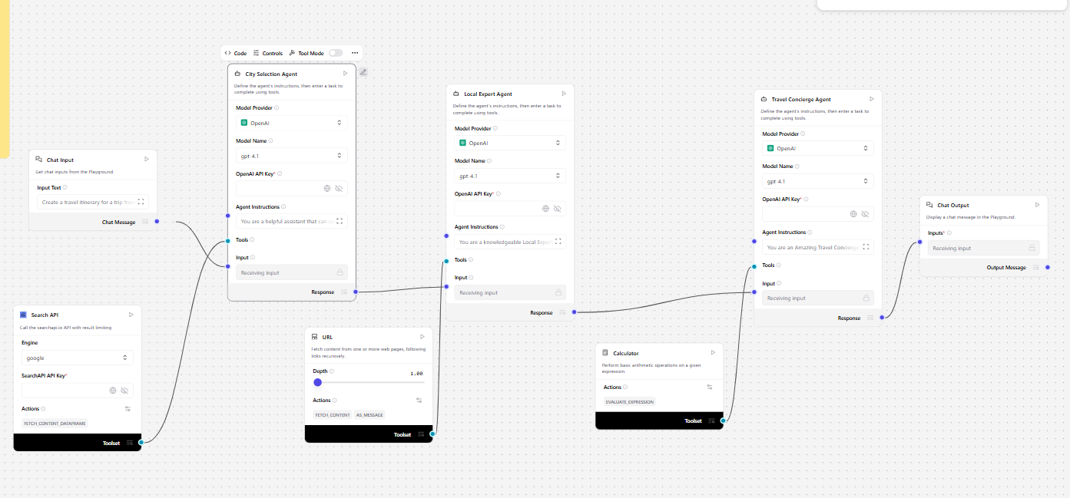
Langflow workflow -

Slide 9
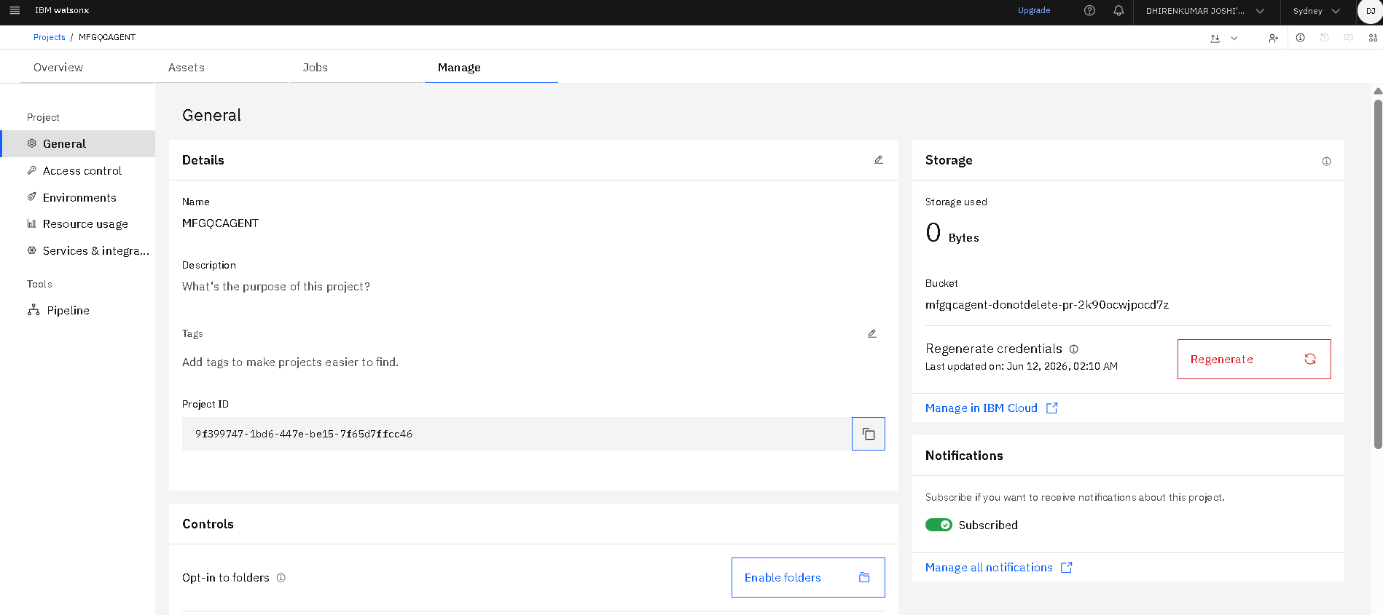
IBM Watsonx.Ai PROJECT CREATED

Slide 10
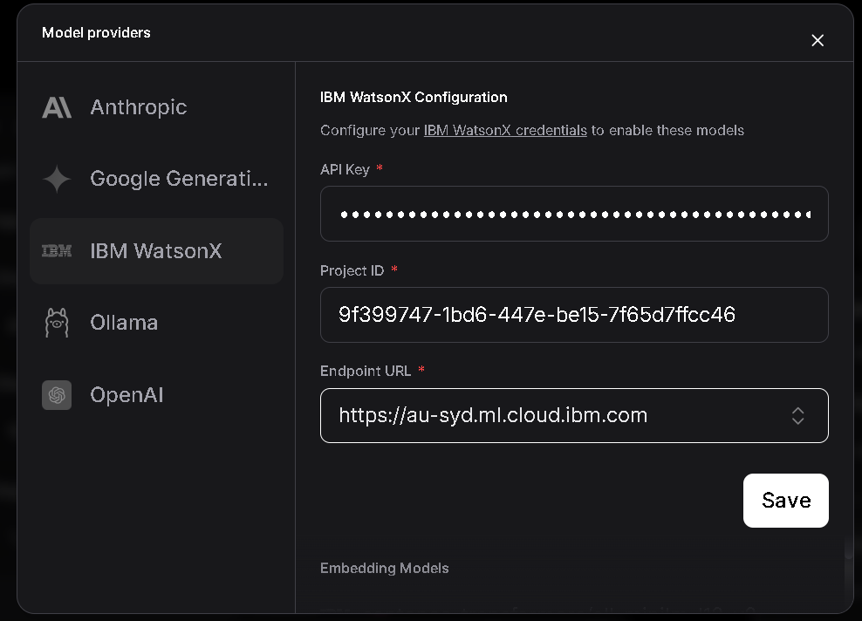
IBM Watsonx.Ai knowledgebase entered in Langflow

Slide 11
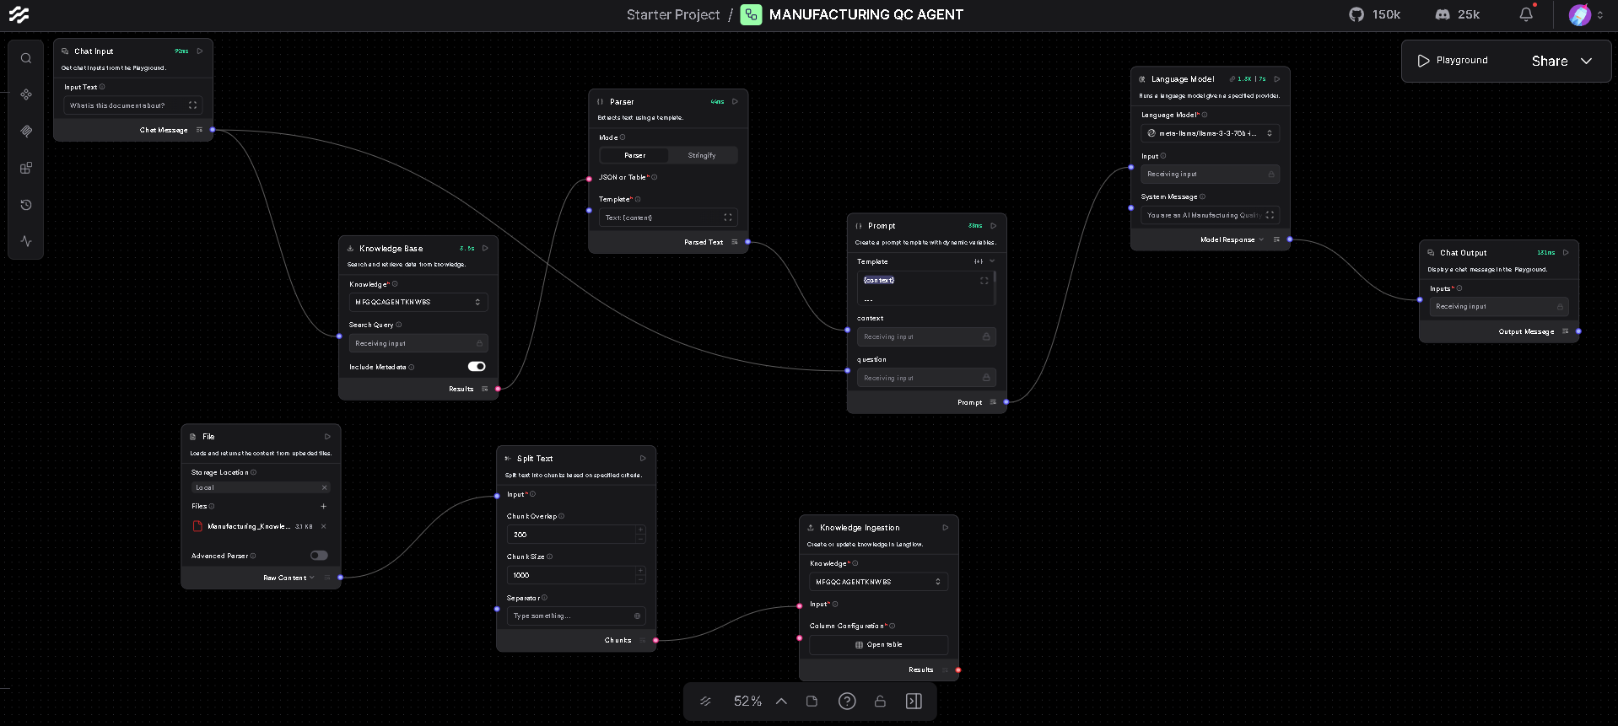
Final Langflow

Slide 12
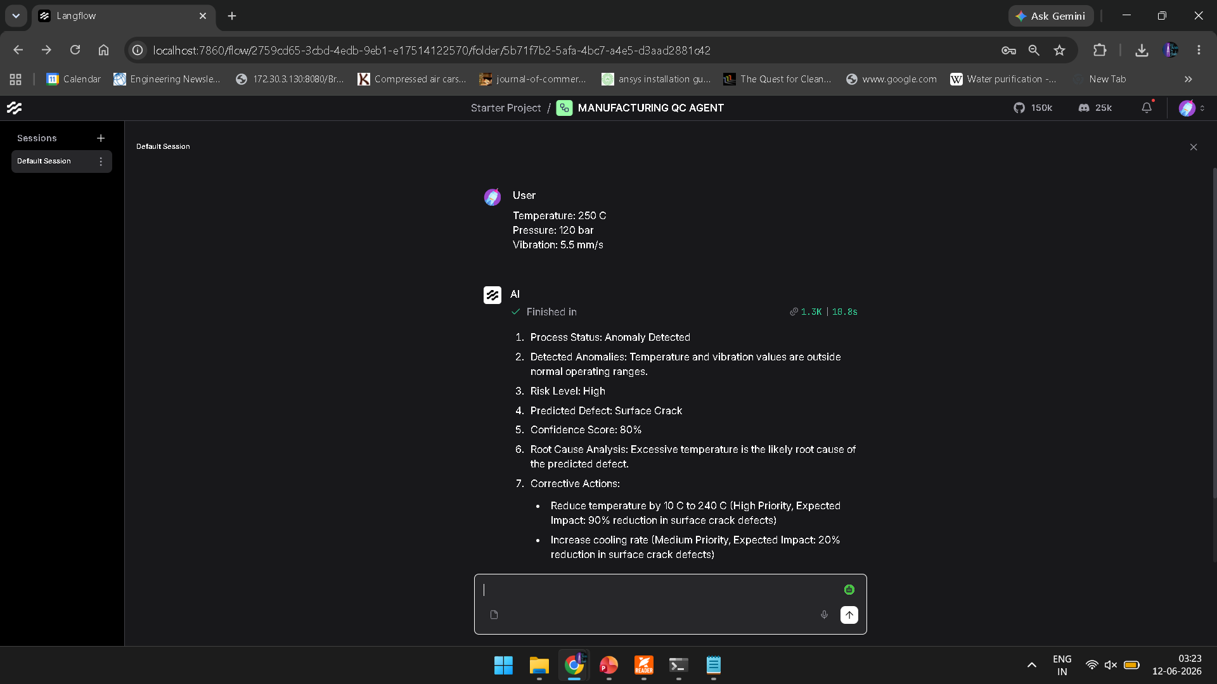
Test Case used in MFGQCAGENT

Slide 13
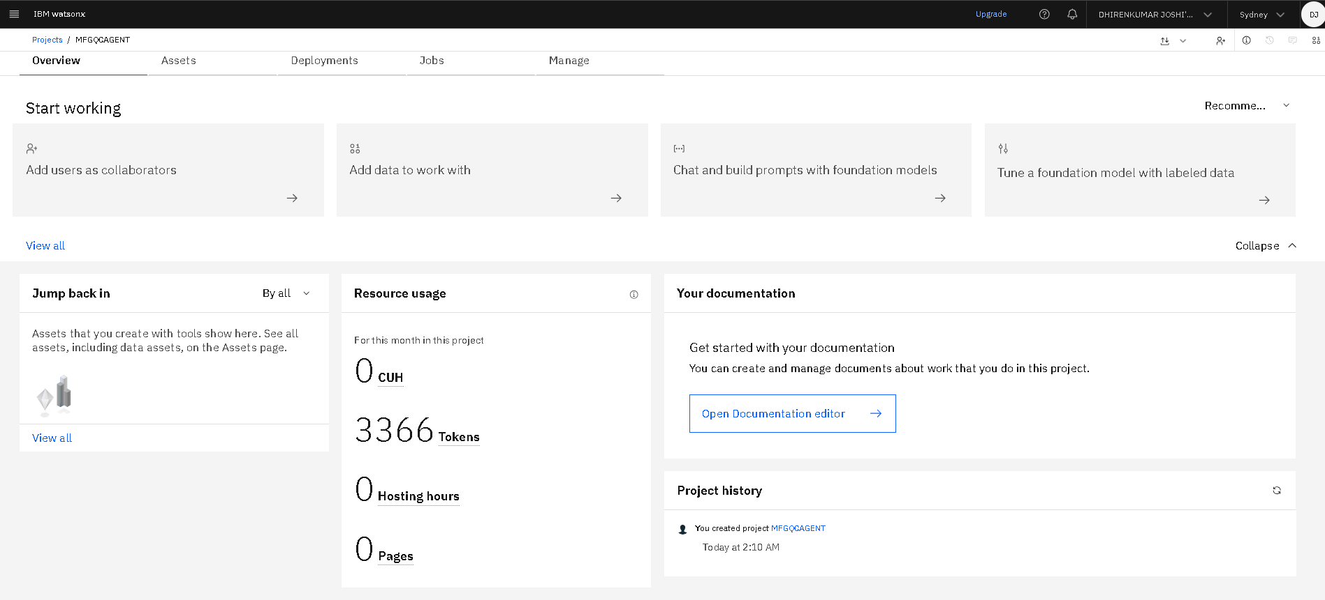
Token Usage

Slide 14
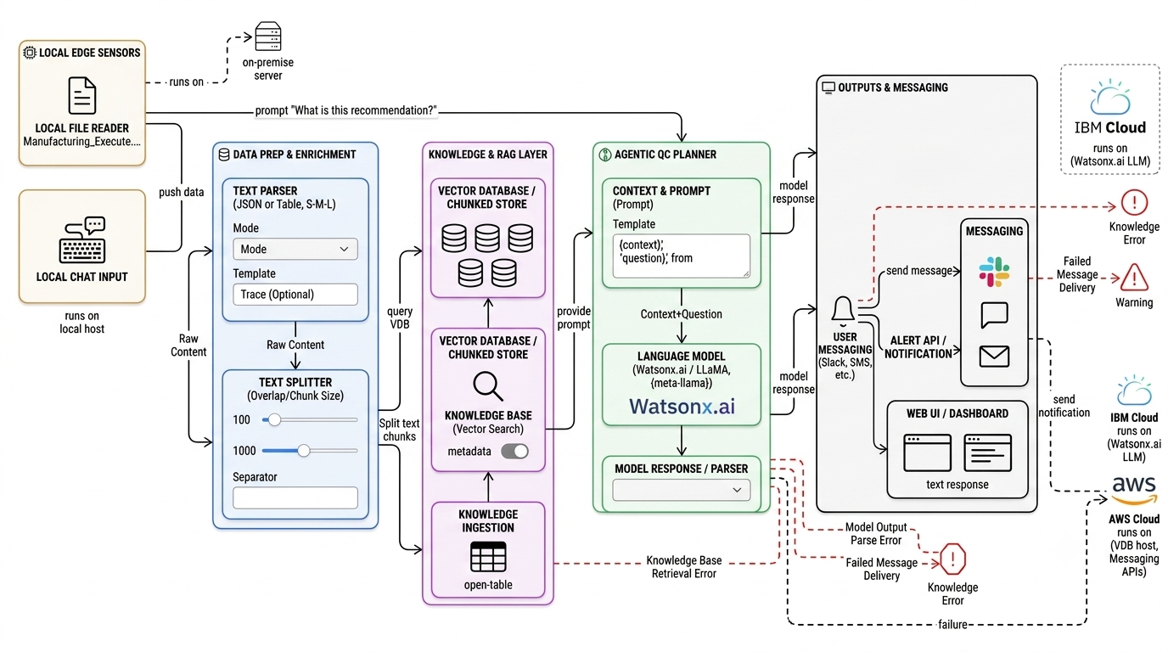
Architecture blueprint

Slide 15

Role of Agentic AI in the solution
The Agentic AI acts as the central intelligence of the Manufacturing QC Agent. It receives manufacturing data and user queries, retrieves relevant information from the knowledge base, and analyzes process conditions. The agent identifies quality deviations, predicts potential defects, and determines their possible causes. Based on the analysis, it recommends corrective actions to maintain product quality. It coordinates interactions between the RAG knowledge base, Granite LLM, and quality monitoring components. The agent also generates clear quality reports and insights for engineers. This enables proactive quality control and reduces the chances of defective products reaching customers.

Slide 16
Technology Used
Langflow platform -For designing and orchestrating multi-agent workflows visually
IBM Grainte model - for eg – ibm-granite-3-2-8b – For natural language understanding, reasoning, and personalization
IBM Cloud – It provides the infrastructure to build, deploy, and scale the Manufacturing Quality Control Agent efficiently. IBM Cloud enables a reliable, secure, and scalable environment for deploying the Manufacturing Quality Control Agent.
RAG– RAG to fetch real data first, then generate intelligent answers, making the Manufacturing Quality Control Agent more trustworthy and effective.
IBM Watsonx.ai - For model deployment, embeddings, and AI governance
Vector Database (FAISS/Chroma) – For RAG-based nutritional data retrieval

Slide 17
Novelty and Uniqueness
The proposed Manufacturing QC Agent combines Agentic AI, Retrieval-Augmented Generation (RAG), and IBM Granite Models to provide intelligent quality control support in manufacturing environments. Unlike traditional quality inspection systems that only detect defects after production, this solution proactively analyzes process data and predicts potential quality issues before defective products are produced.
The integration of a knowledge base enables the system to retrieve historical defect cases and quality standards, resulting in more accurate and explainable recommendations. The Agentic AI autonomously performs quality analysis, defect prediction, root cause identification, and process optimization without requiring constant human intervention.
The system generates real-time quality insights and corrective actions for engineers through a conversational interface. By combining predictive analytics, knowledge retrieval, and autonomous decision-making in a single platform, the project demonstrates a practical application of Generative AI for smart manufacturing and Industry 4.0 environments.

Slide 18
Git Hub Link
Github URL – https://github.com/djrocks85/FDP-IBM-BVM-DHIRENKUMAR-JOSHI/tree/main
·
·
·

Slide 19
Future Scope
The Manufacturing QC Agent can be further enhanced by integrating real-time IoT sensors and machine data from actual production lines for continuous monitoring.
Advanced machine learning models can be incorporated to improve defect prediction accuracy using large-scale historical manufacturing data.
The system can be connected with ERP and MES platforms to enable automated quality management across the entire production process.
Future versions may support computer vision-based inspection using cameras to detect surface defects automatically. Predictive maintenance features can also be added to identify machine failures before they occur.
The dashboard can be enhanced with real-time analytics, trend forecasting, and automated alert notifications. Multi-plant deployment and cloud-based monitoring can enable centralized quality control across different manufacturing facilities. These enhancements will help industries move towards fully autonomous and intelligent smart manufacturing systems.
·
·
·

Slide 20


